Slide 1

Energy and Nutrition
Fruitful Minds

Slide 2
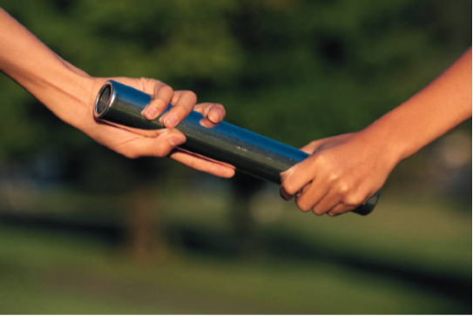
Physical Activity and Nutrition
work as a team

Slide 3
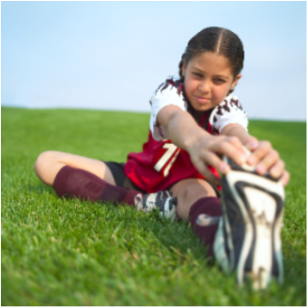
Physical activity is important for health
  Healthy weight
  Lower Stress
  Better mood
  Healthy bones
  Improved thinking and learning
  Improves heart & lungs
  Keeps muscles strong
  Prevent injury
  Better sleep
  Live longer
Notes:
Kids that exercise regularly (60 min/day) use blood sugar more efficiently, protection against type II diabetes
Why do you like to exercise? (ask the class to give examples of how physical activity makes them feel)

Slide 4

Exercise is part of a healthy diet
  Be active for at least 1 hour/day
  Running, walking, playing, dancing, climbing stairs all count as physical activity
  Can you think of other examples?
Notes:
Don’t need a gym or equipment

Slide 5
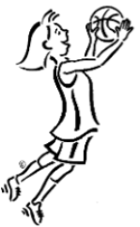
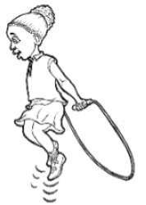
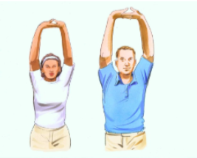
Well-balanced exercise includes:
1) Aerobic
    Increase your heartbeat and breathing over a period of time
    Should be most of your 1 hour/day
    Running, dancing, playing basketball…
Notes:
Key is to find exercise that you love, not boring.

Slide 6
Well-balanced exercise includes:
2) Strength training
    Helps build muscle and keep bones strong
    Push-ups, sit-ups, rope climbing, weight lifting
    This is optional while you are young
    Talk to your doctor before starting a serious strength training program.
Notes:
Key is to find exercise that you love, not boring.

Slide 7
Well-balanced exercise includes:
3) Balance & Stretching
    Increase balance, flexibility, relaxation
    Yoga, stretching
Notes:
Key is to find exercise that you love, not boring.

Slide 8
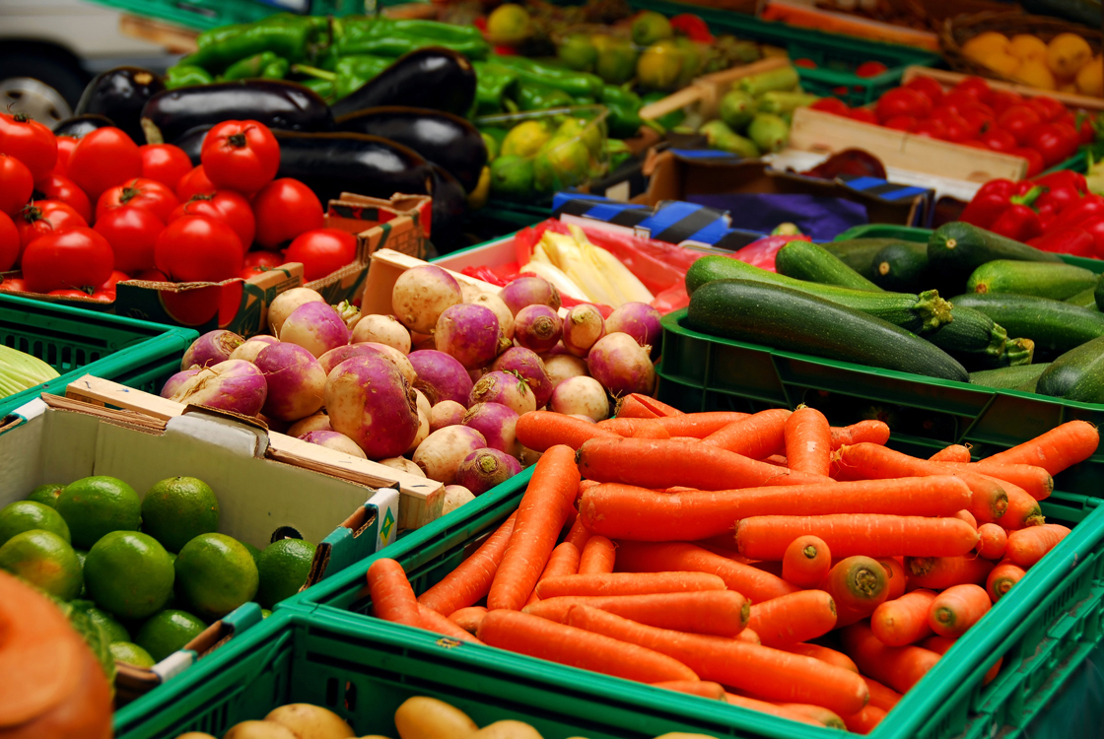
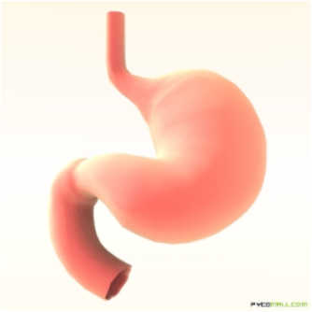
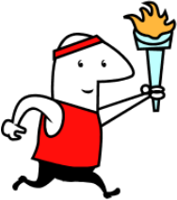
FOOD = ENERGY
After we eat food, we get energy to help our body grow and do different activities!
Notes:
We can measure Energy in the form of Heat…calorimeter demonstration

Slide 9
  You can tell how much energy your food contains by looking at food labels!
  One calorie = one unit of energy

Slide 10

What happens if we are not active?
  The food you eat will be stored as fat!
  This may lead to other problems….
      Weight gain
      Higher risk of Type II Diabetes
      High cholesterol
      High blood pressure
      Osteoporosis (weakening of bones) in older age

Slide 11
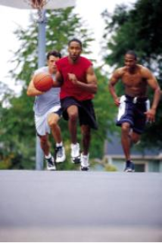




Energy Balance
Out
Physical
Activity
Nutrition
In
ENERGY
Anything left over in the ENERGY balance is stored as fat

Slide 12
Energy Needs
  Your energy needs are individual
How tall are you?
How active are you?
What age are you?

Slide 13
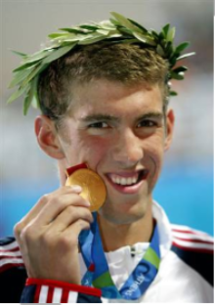



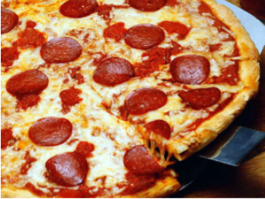
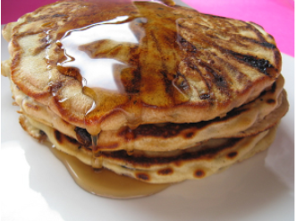
The Michael Phelps Diet
Breakfast
Lunch
Dinner
3 fried egg sandwiches
Chocolate chip pancakes
5 egg omelets
Bowl of grits
3 slices French toast
1 pound of pasta
Energy drink
2 ham and cheese sandwiches
1 pound of pasta
1 entire pizza
More energy drinks
This amounts to 12,000 calories a day!

Slide 14
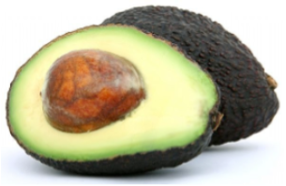

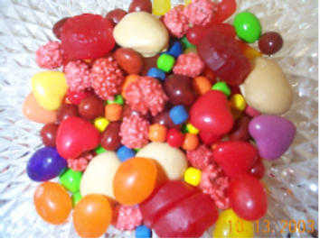
Choosing foods for our energy needs
  Look for balance of carbohydrate,
healthy fat, and protein

